Slide 1
Saving American Education
The Problems - The Causes - The Solutions

Slide 2

Who Is Frank Luke?
Born in India
Bachelor’s Degree in Electrical Engineering
Teacher of 16 years, teaching Math & Physics
Taught in India, Dubai, North Dakota, Alabama, & Florida
Currently teaching at Bay Haven, one of the highest performing schools in Florida

Slide 3
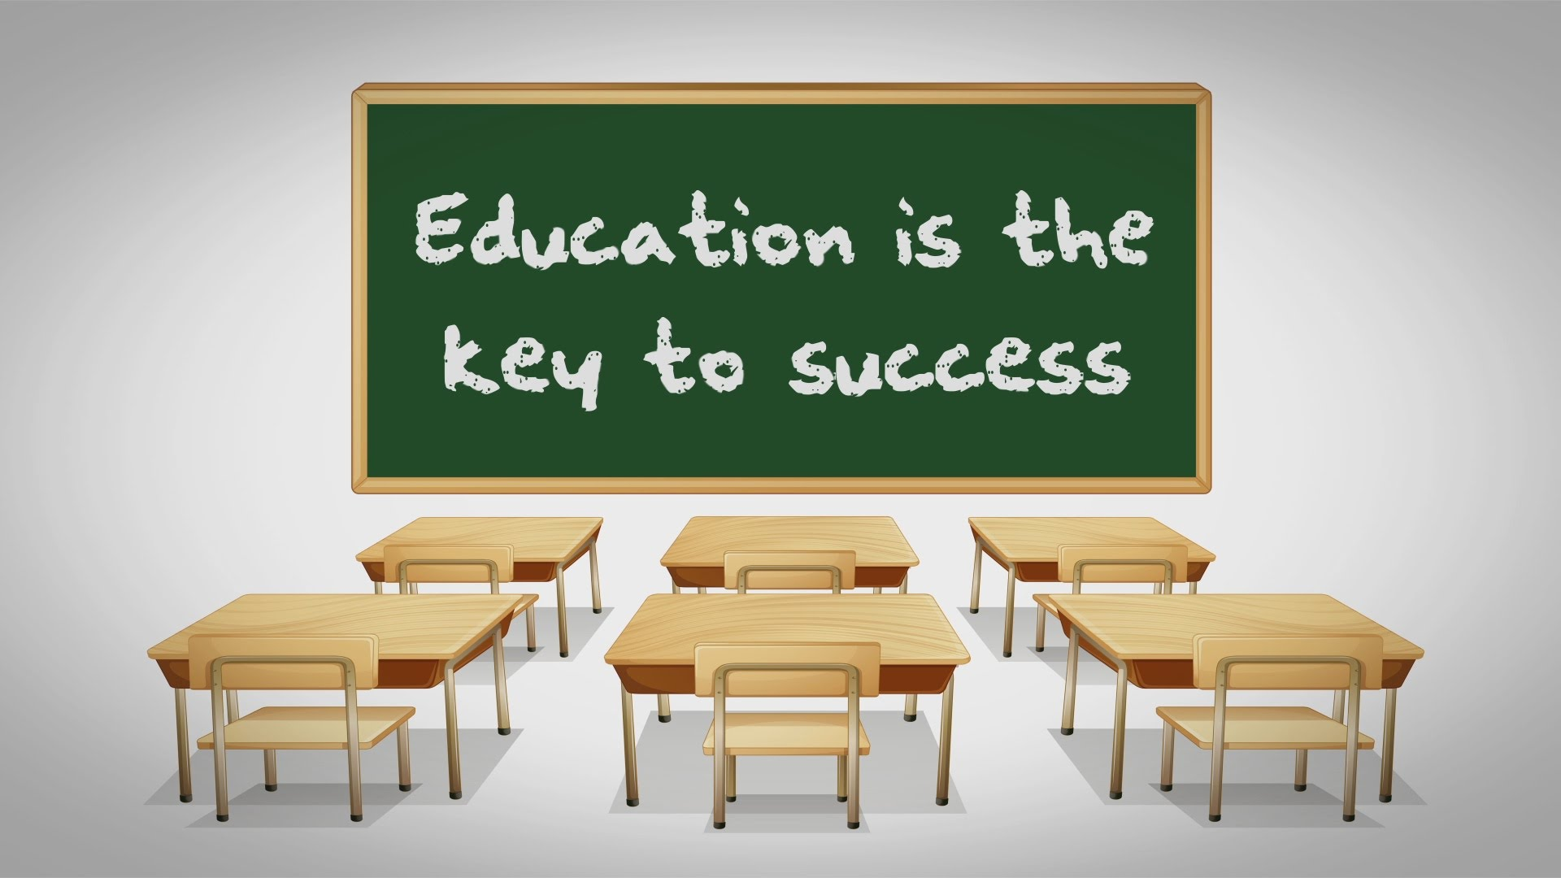
Who Is Frank Luke?
Mr. Luke’s love for America has fueled his ambition to pull American Education out of the murky waters of bureaucratic dysfunction.

Slide 4
The Problem
50 million+ students are in schools across the United States.
70% of these students (about 35 million) are being given false grades to cover up their lack of academic skills.
False grades are being given by all 50 State Departments of Education.
When 70 percent of anything is defunct, it represents a major breakdown.
In order to fix the breakdown, we need to fix the
State Departments of Education.
Education is not what we teach.
Education is not what we learn.
Education is what we retain of what we have learned.
Mr. Luke

Slide 5
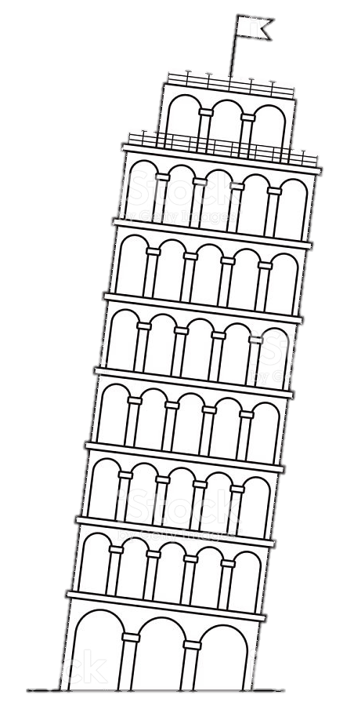

The Problem
No False Grades
False Grades

Slide 6
The Problem
Education is not what we teach.
Education is not what we learn.
Education is what we retain of what we have learned.
By that token, if students forget 60% of what they “learn”, it represents a hollow system of education.

Slide 7
Verification of the Breakdown
We need to give the 7th grade standardized math test to students from grades eight to twelve. When we do this, we will see 70% of them fail. They will not fail because they lack intelligence-they will fail because they are not familiar with basic mathematical concepts. Their math grades do not reflect their academic skills. They are false grades.

Slide 8
What Went Wrong?
State standards for mathematics are not realistic-the amount of information we expect students to absorb is illogical. Most students forget the bulk of what they learn.
State standards, curriculums, textbooks, and teaching need to seamlessly blend with one another. Currently, they are disjointed.
State Boards of Education are formed by governors who appoint honorable men and women who know little about education in the classroom. As a result, their decisions are based on wishful thinking, not on ground realities.
Billions of dollars are wasted on unproductive activities, including ineffective teacher training programs.

Slide 9
The Breakdown
The American Education System is undergoing a two-pronged breakdown, one that is systemic and one that is structural.
Structural Breakdown
Systemic Breakdown
The Broken Structures
The Broken System
State Depts. of Education
State Boards of Education
This broken structure has created…
The State Standards
The Text Books
The Testing

Slide 10

The Crippled System
The crippling of the American Education System is primarily due to the imprudent time distribution that occurs within it, divided between the learning, practicing, and testing of concepts.
jjjjjjjjjjjjjjjjjjjjjjjjjjjjjjjjjjjjjjjjjjjjjjjjjjjjjjjjjjjjjjjjjjikkkkkkkkkkkkkkkkkkkkkkkkkkkkkkk

Slide 11
The Crippled System
The Current (Broken) Time Distribution Percentages: | Time Distribution as it should be:
Learning of Concepts- 45% Practicing of Concepts- 10% Testing of Concepts- 45% | Learning of Concepts- 18% Practicing of Concepts- 80% Testing of Concepts- 2%
jjjjjjjjjjjjjjjjjjjjjjjjjjjjjjjjjjjjjjjjjjjjjjjjjjjjjjjjjjjjjjjjjjikkkkkkkkkkkkkkkkkkkkkkkkkkkkkkk

Slide 12
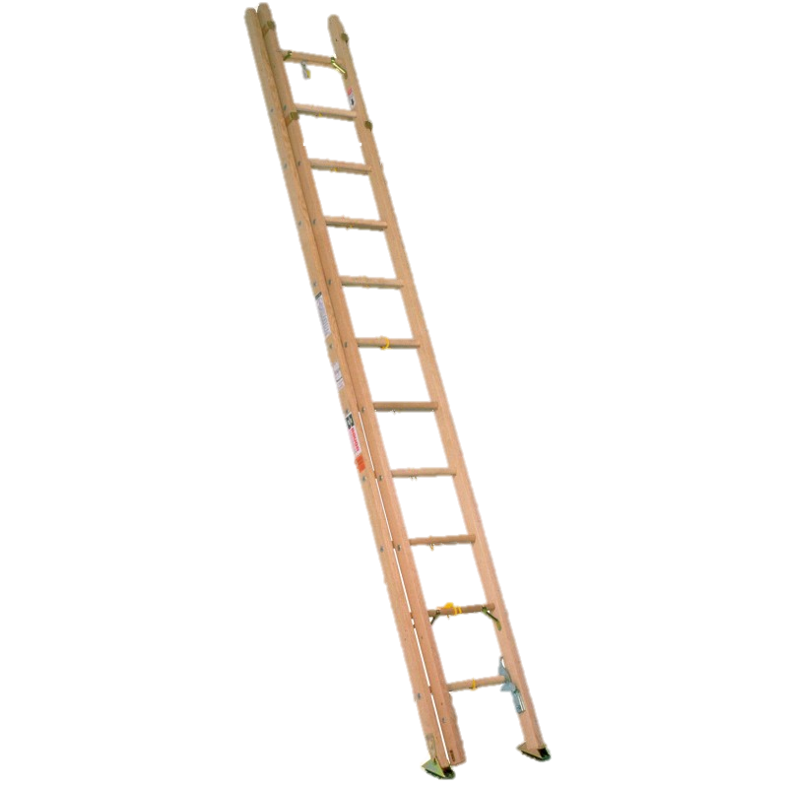
The Academic Levels
Academically Great
Academically Excellent
Academically Good
Academically Sound
Academically Serious
Academically Crippled
Academically Frivolous

Slide 13
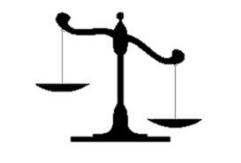
The Academic Levels
American Education is floundering between the bottom two levels.
Academically
Crippled
Academically Frivolous

Slide 14
The Solution
Verify the Breakdown
Appoint someone from the classroom as State Secretary of Education
Let the Secretary of Education appoint ten men and women as a Task Force.
Allow the Task Force to reform state standards and mend the large gaps between the standards, curriculums, textbooks, and teaching.
The reforms must be introduced stage-wise:
- From Kindergarten to Third grade
- From Fourth grade to Sixth grade
- From Seventh grade to Ninth grade
- From Tenth grade to Twelfth grade

